Slide 1
Session # 3: “Strategic Management” 30 January 2019
16:00-17:00
Hosted by ITC and People-Centered Internet

Slide 2
Strategic Management- Introduction
Session Objectives: Identify the direction of business, connect to new opportunities, and address challenges in starting a new businesses
Proposed Agenda:
Guest Presentation (40 min)
Q&A (10 min)
Follow-up Assignment and Closing Discussion (5 min)
Questions from the Audience:
Please type your question in the chat box, including your name and organization.
If time does not allow your question to be answered during the session, the moderator will send it to the guest speaker to respond in writing.

Slide 3
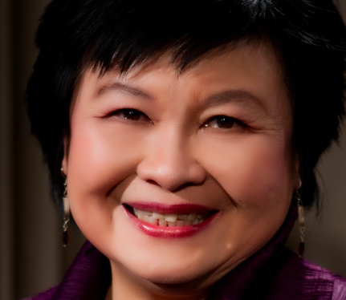
Session # 3: Guest Speaker
Guest Speaker:
Ms. Mei-Lin Fung, People- Centered Internet

Slide 4
Strategic Management
BY MEI LIN FUNG
People Centered Internet
https://peoplecentered.net
Notes:
Wireframes, Google sheets, etc

Slide 5
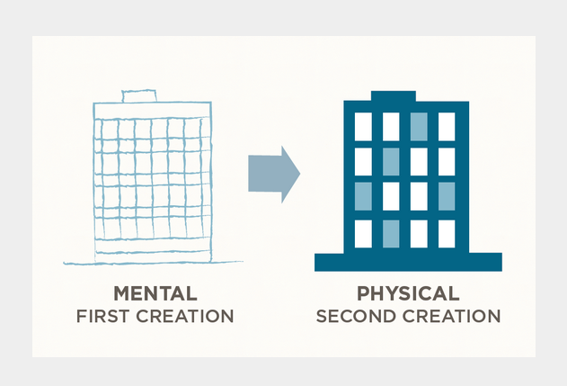
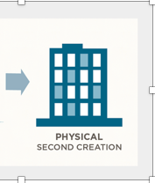
What is Strategic Management?
Vision
TEAM
OPERATIONS
THIRD
Start with the End Product
OUTPUTS AND OUTCOMES
Team works out how they be achieved
References
Covey Habit 2: Begin with the End in Mind
https://www.franklincovey.com/the-7-habits/habit-2.html
Diagram adapted from the Franklin Covey original
Convert materials $’s, expertise & skills
into
Outputs Outcomes
People Centered Internet https://PeopleCentered.net Mei Lin Fung - mlf@alum.mit.edu
Notes:
Wireframes, Google sheets, etc

Slide 6
What’s the difference between outputs and outcomes?
Output is what you can control that you deliver to the customer
Outcome is the effect on the customer as a short, medium or long term result
Reference
https://www.sysaid.com/blog/entry/the-difference-between-outcomes-and-outputs-makes-a-difference

Slide 7
Strategic Management is how we steer to stay on course to our destination
1. Strategy = Map to reach the destination via milestones
2. How is the team to steer to milestones?
3. Goals & Indicators provide the Rudder to stay on course
So no one person has
to remember everything
Reference: Top 100 Leadership Quotes
https://www.forbes.com/sites/kevinkruse/2012/10/16/quotes-on-leadership/#716634362feb

Slide 8
Balanced Scorecard A tool for managing and explaining our strategy to investors and team members Reference: https://bscdesigner.com/real-bsc-examples.htm
Cashflow $

Slide 9
Divide attention between 4 Management Areas
Every business steers a delicate balance between competing priorities
Cashflow
Internal Operations
Innovation & Learning
Win & Keep Customers
External to
company
Strategy
Internal to
company

Slide 10
How are we organizing ourselves so we can create products and services that generate income? How can we keep our costs to a minimum and deliver value?
Reference: https://www.ondeck.com/resources/what-is-operations

Slide 11
How are we recruiting team members? How do we improve what we are doing? How can people become more capable? How can we learn from others? How can we share what we have learned?
Reference:
http://marketerstouchpoint.com/blog/what-is-the-difference-between-design-thinking-and-service-design-thinking/

Slide 12
How do we attract new customers? How do we keep our customers trust? Why will customers come back? How can we ask customers to refer us to their networks?
Reference:
https://www.agilitypr.com/pr-news/public-relations/new-customer-experience-blurring-retail-models-create-massive-challenges/

Slide 13
Who is our competition?
How is our industry changing?
Who can be partners and allies?
What are the opportunities?
What are the threats we must prepare for?
Reference:
https://hbr.org/2014/11/how-smart-connected-products-are-transforming-competition

Slide 14
What can we do to increase revenues?
What can we do to decrease costs?
What gaps need to be filled on our team?
What gaps do we need to fill in our operations?
Reference:
https://www.strategy-business.com/article/10-Principles-of-Strategy-through-Execution?gko=7f785

Slide 15
How much do we have to pay in the next quarter?
How much are we earning in the next quarter
Does revenue fluctuate and how can we adjust?
Do we need to raise capital or get a loan – if so
What will we spend the money on?
Reference:
https://www.allbusiness.com/managing-cash-flow-seasonal-small-business-106086-1.html

Slide 16
Join us to create a book for people like us!
A playbook in partnership with EQUALS
For and by female entrepreneurs
Focusing on how to raise your first funds
Your voice matters! Let’s create something practical!
Please share your experiences and challenges
You Got Funded – playbook research form
EQUALS Women-in-Tech Taskforce – Singapore Chapter
Photo Credit https://www.cnn.com/travel/article/global-passport-index-Singapore/index.html
Notes:
https://docs.google.com/forms/d/e/1FAIpQLSdEG188HVaTCsZbip5C4y2TiHj0_icOoBXcsQDjIHWLtrAxWA/viewform

Slide 17
Leaders in a Chaotic World Use Network Skills
Assignment
Option 1: Take any two of the slides 10- 15 and describe the actual indicators you are going to track for your business.
Option 2: Practice these skills – at least 1 per day and practice each skill for 3 days. What worked? What didn’t work?
Send in your assignment to mlf@alum.mit.edu by February 15, 2019 to get a grade and written response.

Slide 18
Q&A

Slide 19
Upcoming Sessions

Slide 20
Questions? Contact Us
For any course-related inquiries, please contact: womenandtrade@intracen.org
(using subject line: “EQUALS Business and Leadership Course”
For any questions about the EQUALS Global Partnership, please contact: equals@itu.int
Thank you!

